Slide 1


SHOE SALES SYSTEM
Introduction to Database System
Login: NGU0120 – Nguyen Thanh Tuan

Slide 2

WHY
Shoe Sales System will solve the selling problem, and users will choose which shoes they want to buy.

Slide 3
WHO
Administrator
Seller
Buyer

Slide 4
FUNCTION
The system is interested in products uploaded by the seller. Products are paid and the users will be recorded in the payment history.
If the shoes are sold out, the seller will mark the product as sold out (SOLD OUT). After the product is selected and paid, the user will be recorded in the payment history.
When the user pays, the money will be transferred into the system. When the user receives the product, the money will be transferred to the seller.

Slide 5
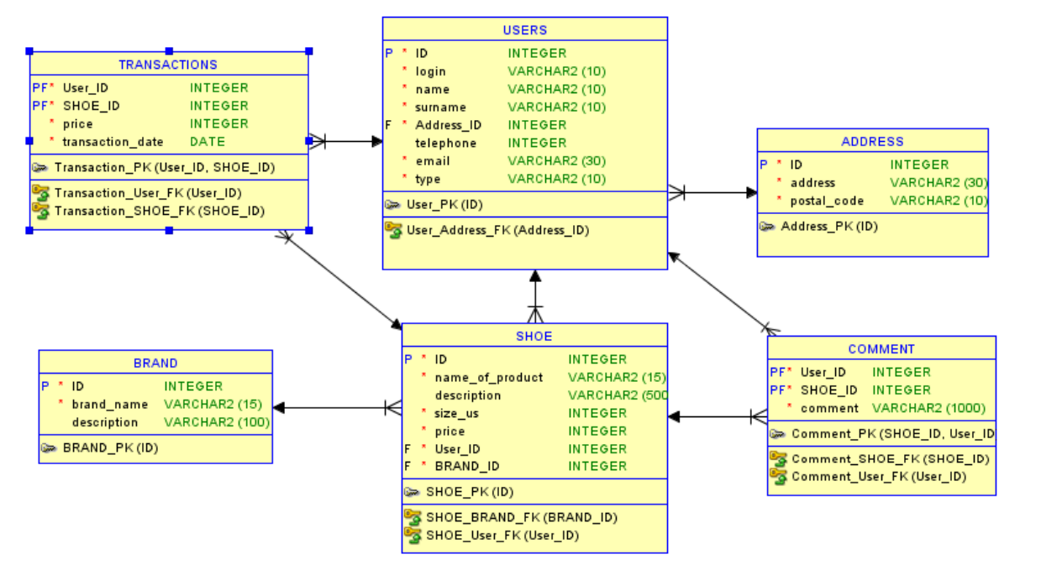
RELATIONAL MODEL

Slide 6
THANK YOU FOR LISTENING

